Slide 1
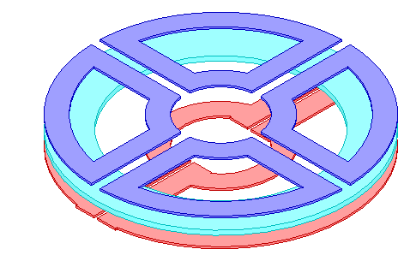
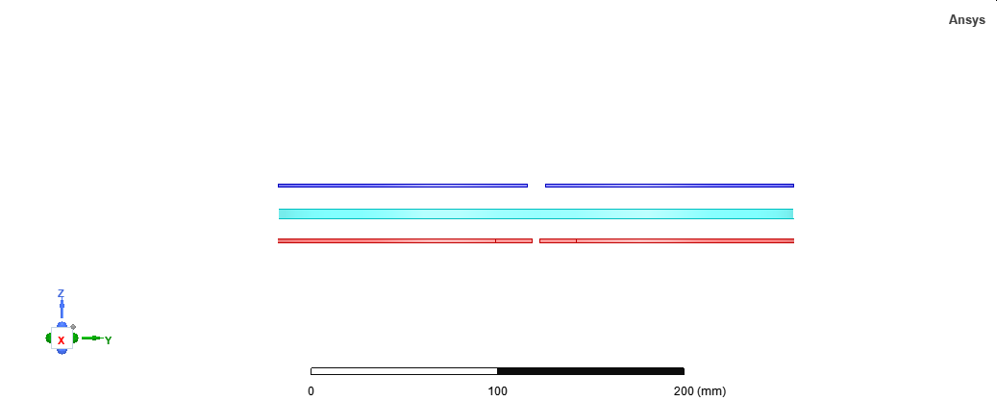
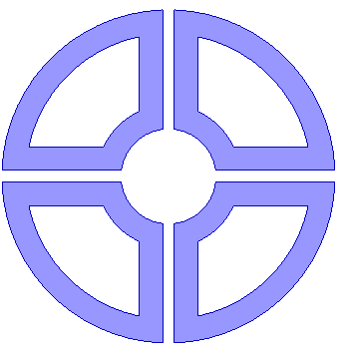
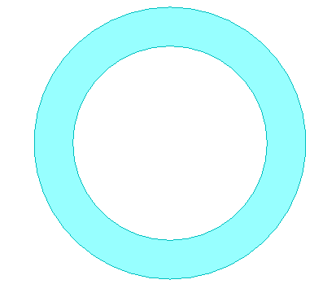
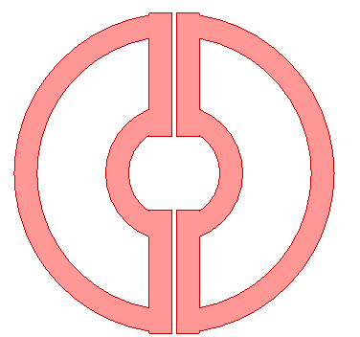
Rx
MSR
Tx
End-windings
x
y
4 Rx coils
1 MSR coil
2 Tx coils

Slide 2
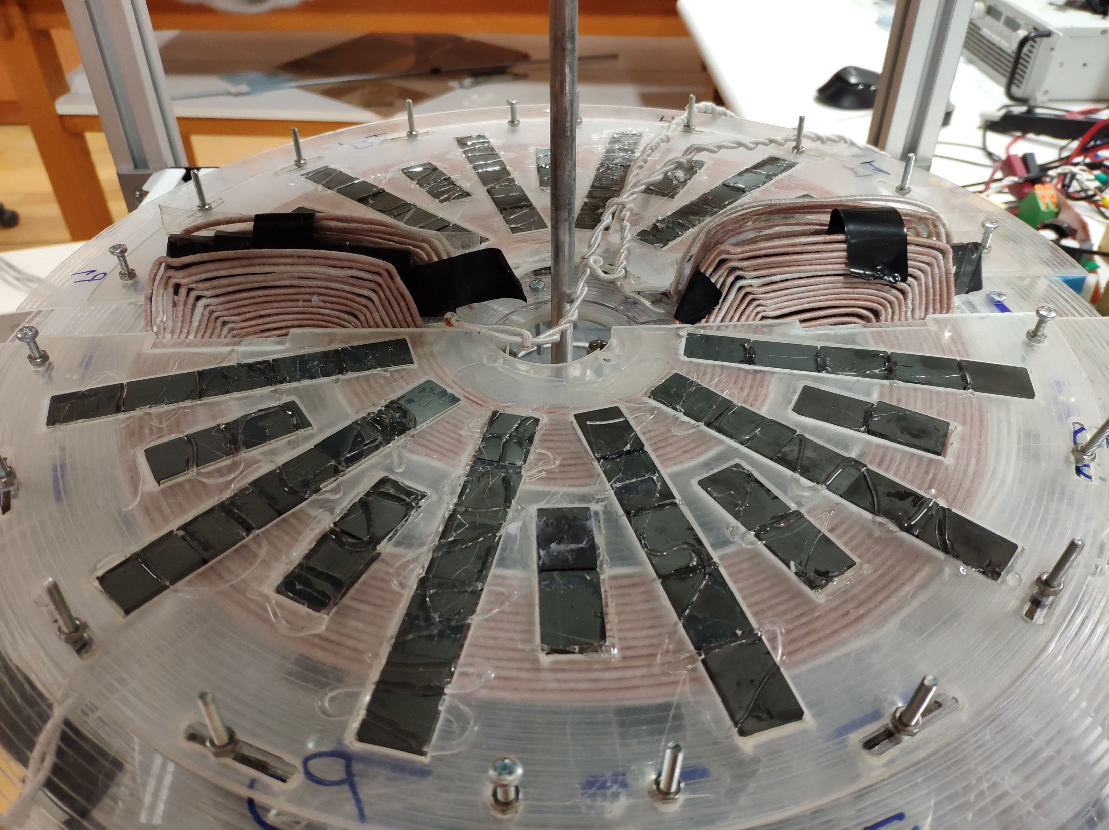
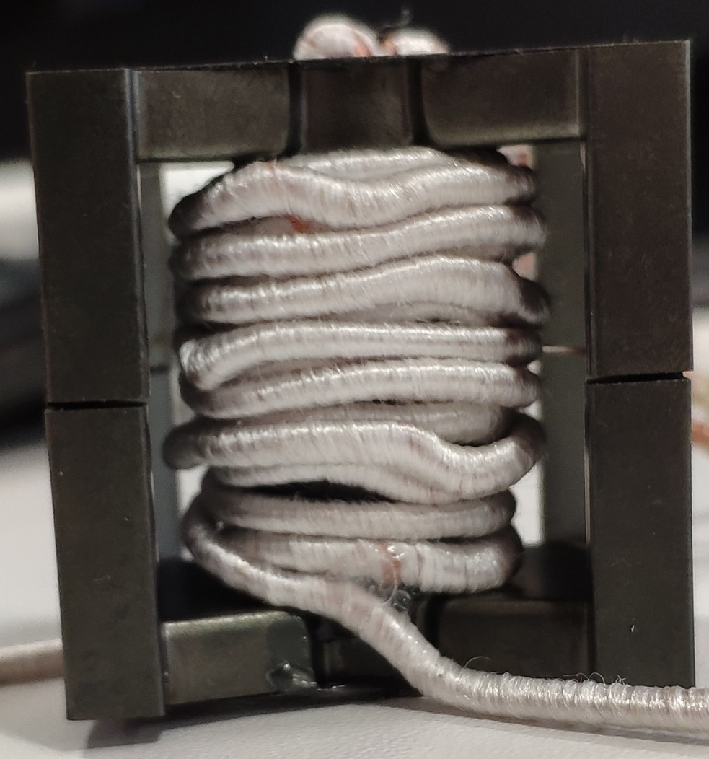
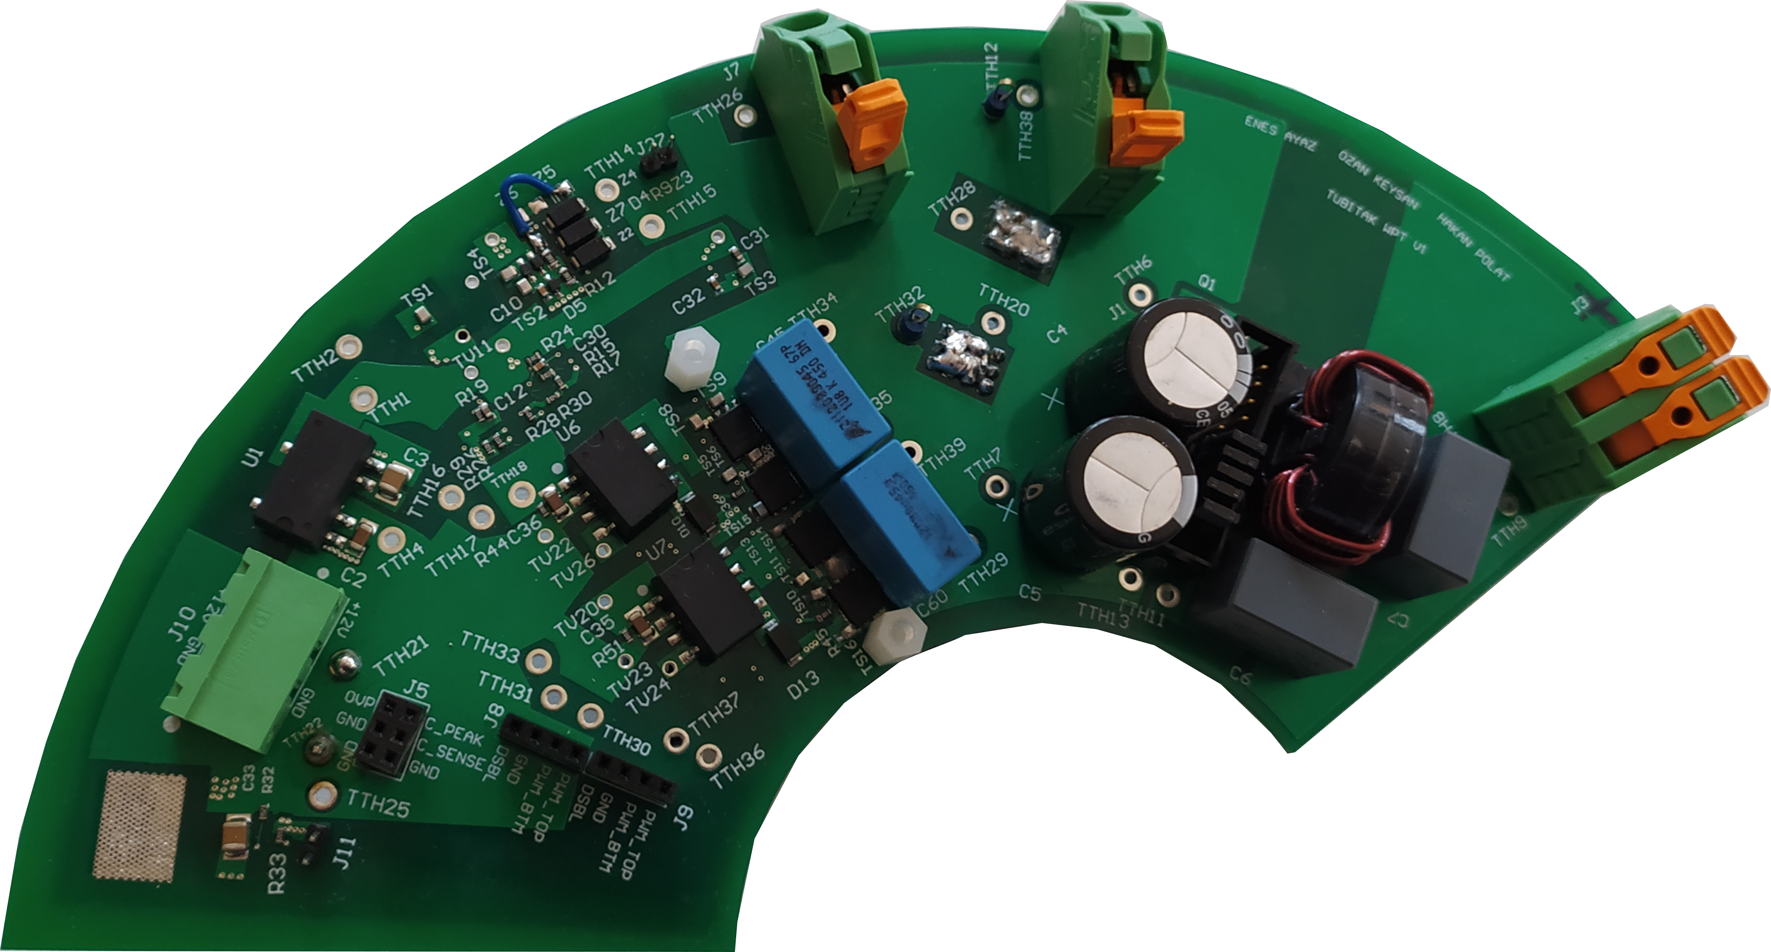
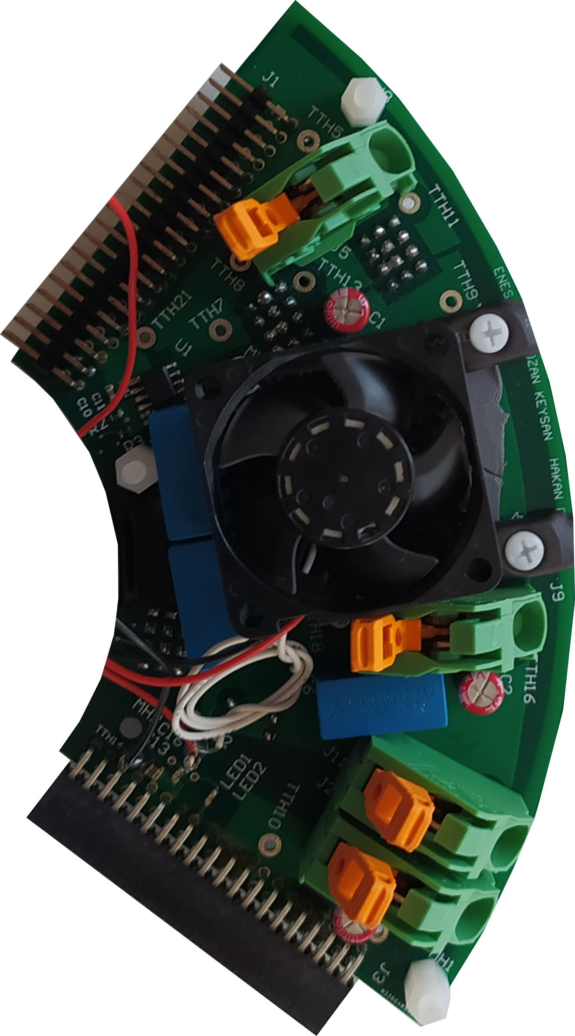
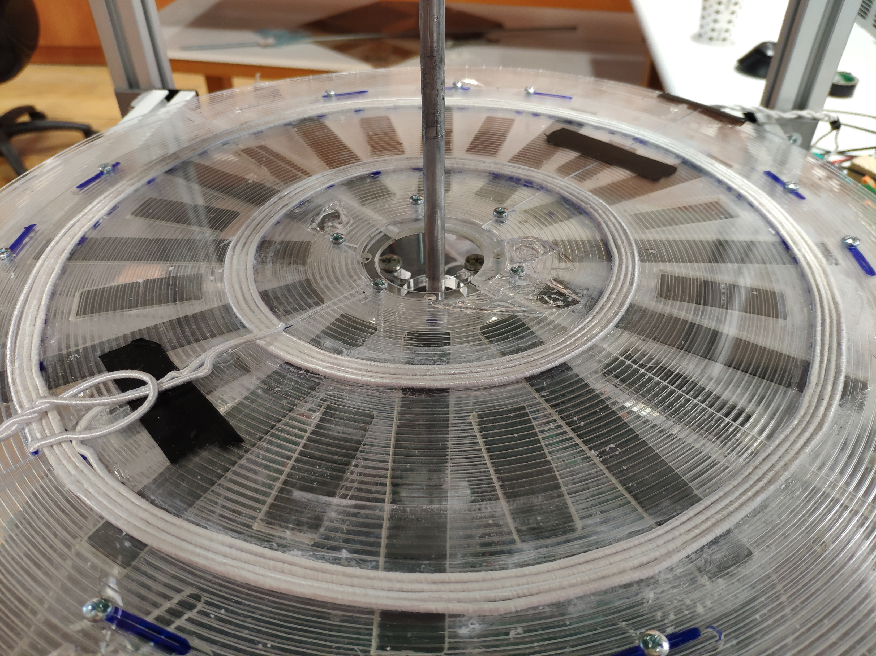
Rx/MSR coils
(HFCI)
Tx coils
DC/AC
converter
AC/DC
rectifier
MSR coil

Slide 3
Rx
MSR
Tx
End-windings
x
y
4 Rx coils
1 MSR coil
2 Tx coils

Slide 4
ωm
Rx
MSR
Tx
End-windings
x
y
4 Rx coils
1 MSR coil
2 Tx coils

